Slide 1
Secure data hiding in images using steganography
CAPSTONE PROJECT
Presented By:kavya k
Student Name : kavya k
College Name & Department :Reva university btech cse

Slide 2
OUTLINE
Problem Statement
Technology used
Wow factor
End users
Result
Conclusion
Git-hub Link
Future scope

Slide 3
Problem Statement
In today’s digital age, ensuring data security and privacy is a top priority. Traditional encryption methods are often prone to detection and interception. Our project tackles this challenge by using steganography to hide secret messages within images. This method offers a covert communication channel, enhancing data confidentiality without raising suspicion

Slide 4
Technology used
1. Libraries Used:
cv2 (OpenCV):Used for image processing (reading, modifying, and saving images).
cv2.imread() loads the image.
cv2.imwrite() saves the modified image.
os:
Used to interact with the operating system.
os.system("start encryptedImage.jpg") opens the saved image on Windows.
string (although not used explicitly in the code):
Typically used for string operations, but it's unnecessary here.
2. Tools and Functionalities Used:
Steganography (hiding a secret message inside an image).
Dictionary-based character encoding (d and c dictionaries store mappings between characters and their ASCII values).
Basic encryption/decryption logic using pixel values.
User input handling (input() for taking a secret message and a passcode).

Slide 5
Wow factors
Steganography Implementation
The code hides a secret message inside an image by modifying pixel values.
This is a simple yet effective way of encoding information in an image.
Minimal and Efficient EncodingThe message is directly stored in the image pixels without using external libraries for encryption.
The use of ASCII character mapping (d and c dictionaries) makes encoding and decoding straightforward.
Interactive Encryption and Decryption
The program asks the user for a message and passcode, making it interactive.
The decryption step ensures that only authorized users can retrieve the message.
Cross-Domain UsageThis method can be applied in cybersecurity, watermarking, and secret communications.
Can be extended to work with different file formats, colors, or even videos.
Opens Image AutomaticallyThe os.system("start encryptedImage.jpg") command automatically opens the modified image, making it user-friendly.

Slide 6
End users
Security professionals and cybersecurity enthusiasts.
Journalists, activists, and government agencies needing secure communication channels.
Students and researchers interested in data privacy and steganography.
General users looking for enhanced digital security.

Slide 7
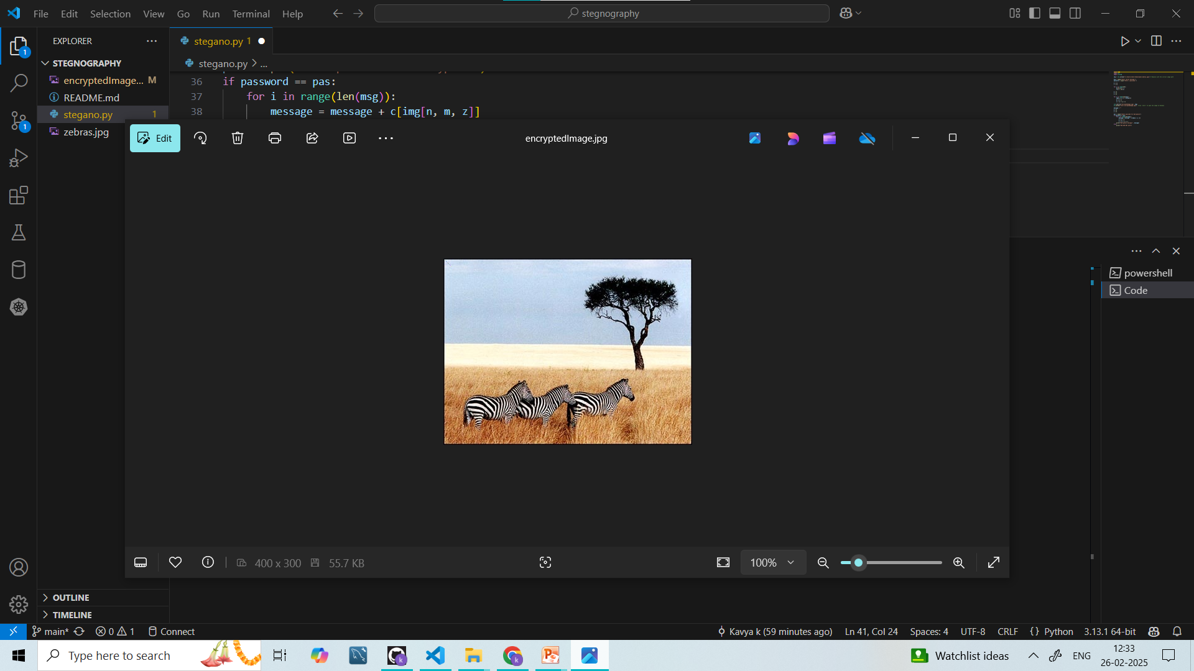
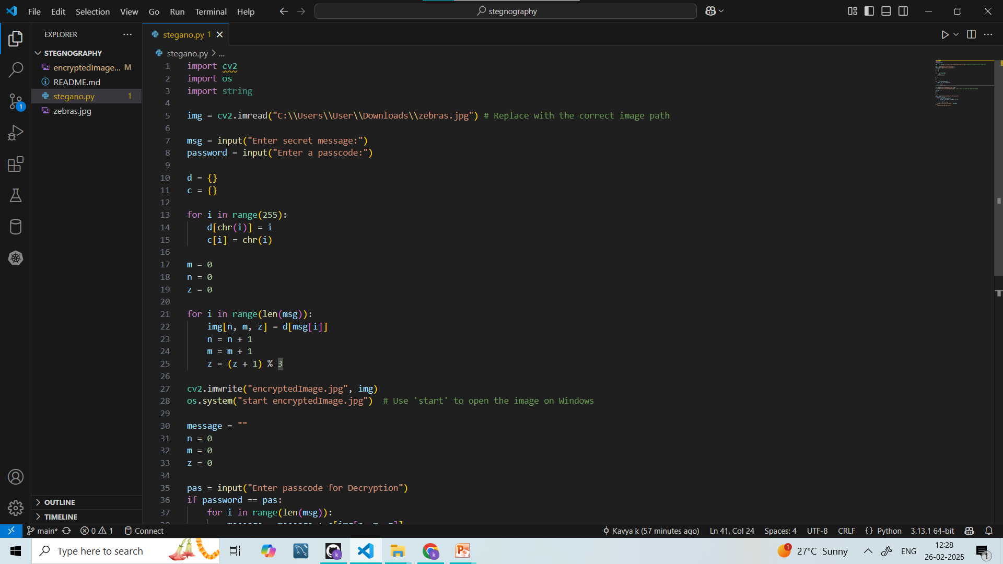
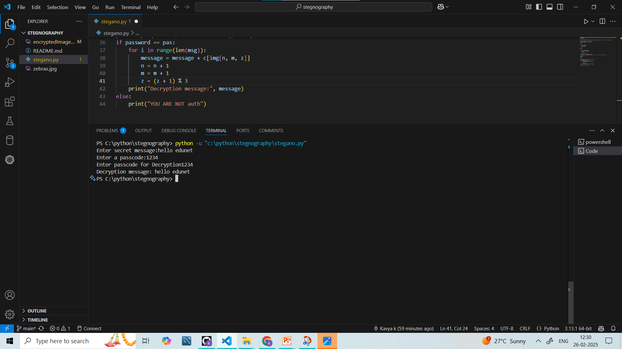
Results

Slide 8
Conclusion
This Python script successfully demonstrates a basic steganography technique by hiding a secret message inside an image using pixel manipulation. The use of OpenCV (cv2) for image processing and dictionary-based character encoding makes the approach simple yet effective.
Key takeaways:
1. Steganography in Action – The script modifies pixel values to encode a secret message, making it a creative application in cybersecurity and data hiding.
2. Interactive & Secure – It includes user input for encryption and a passcode-based decryption mechanism.
3. Practical Implementation – Can be extended for real-world applications like digital watermarking, secure messaging, or hiding data in multimedia files

Slide 9
GitHub Link
https://github.com/kavyakrishnank/secure-data-hiding-in-image-using-steganography.git

Slide 10
Future scope(optional)
Support for multiple image formats and higher resolution images.
Extend the approach to video steganography for dynamic data hiding.
Incorporate advanced encryption algorithms to further secure the hidden message.
Develop a web-based or mobile application for broader accessibility.
Explore automated detection and extraction tools for steganographic content

Slide 11
THANK YOU

